Slide 1
Refactor .NET Core Web APIs to Serverless APIs using Azure Functions
By
Ashirwad Satapathi

Slide 2

Meet Ashirwad Satapathi | @ashirwad_1998
Associate Software Developer
C# Corner MVP
Cloud Enthusiast
Focused on ASP.NET Development
UiPath Certified RPA Developer
To Connect
Github - AshirwadSatapathi
Twitter - @ashirwad_1998
Linkedln - https://www.linkedin.com/in/ashirwad-satapathi/

Slide 3
Agenda
1. What is API
2. How can we make one ?
3. Evolution of Application hosting platform
4. What is Serverless
5. Azure Functions
6. Problem Statement
7. Have a Look at the Web API
8. Refactor our .Net Core Web API to a Serverless API
9. Publish them in Azure

Slide 4
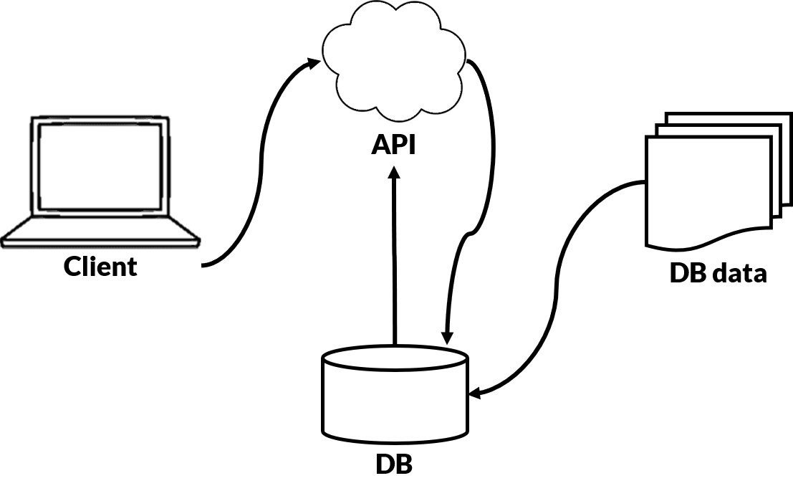
What is an API

Slide 5
How can we make one
Web APIs in .Net
Django / Flask in Python
Express.Js in Node.Js
Spring in Java

Slide 6



Evolution of the Application Hosting Platfrom
Buy a Mansion
Rent the Mansion
Rent a Small Flat
Rent a room in Oyo
On-Prem
IaaS
PaaS
Serverless

Slide 7
What is Severless
Event Driven
Stateless
Micro-Billing
Abstraction of
Servers

Slide 8
Azure Functions
Event Driven
Stateless
Function
as a
Service
Micro-Billing
Abstraction of
Servers

Slide 9
How can we make one ?
Azure Portal
Azure CLI
Visual Studio
Visual Studio Code

Slide 10
Let's make one using Azure Portal

Slide 11
Problem Statement
Your working at an Organization,India Inc and off late you organization has been not able to retain many of its existing customers. To understand this, You are sharing a feedback form with your customers to share their experince with your organisation. Now the mangements want to receive all the negative feedbacks shared by the customer to address these concerns and work on them.

Slide 12
Have a Look at the Web API

Slide 13
Rewrite it using Azure Functions to make an Serverless API to solve the problem statement

Slide 14
Let's Deploy it

Slide 15
QnA

Slide 16
Thank You and Stay Safe

